Slide 1









A
Map
Update
B

Slide 2
Quarterly Update
www.themegallery.com
2014Q2
2014Q3
2014Q4
2014Q2
2014Q4
2014Q3
Company Logo

Slide 3








Map Data Changes
www.themegallery.com
ADD
Delete
Update
31370
77101
Delte
Update
Company Logo

Slide 4
Incremental steps
1
Initialliztion
2
Prepare
3
Apply
4
CleanUp

Slide 5
















Slide 6
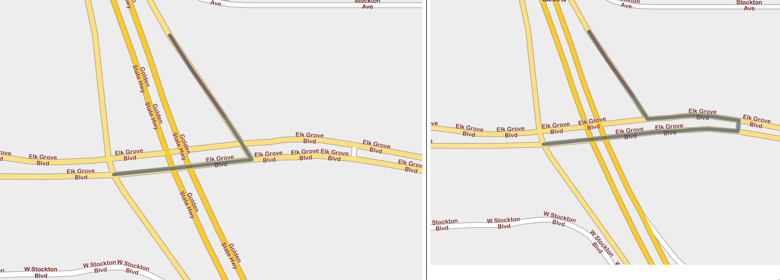
Samples

Slide 7
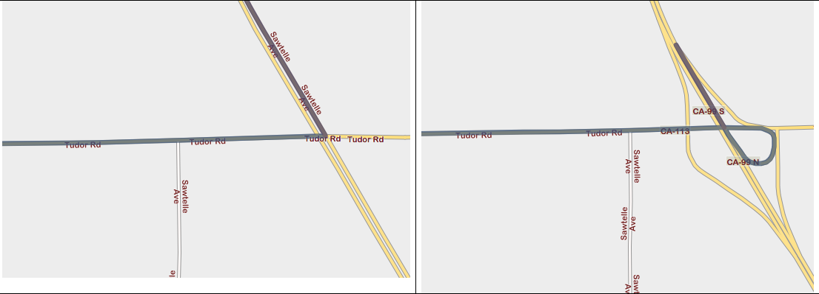
Samples

Slide 8
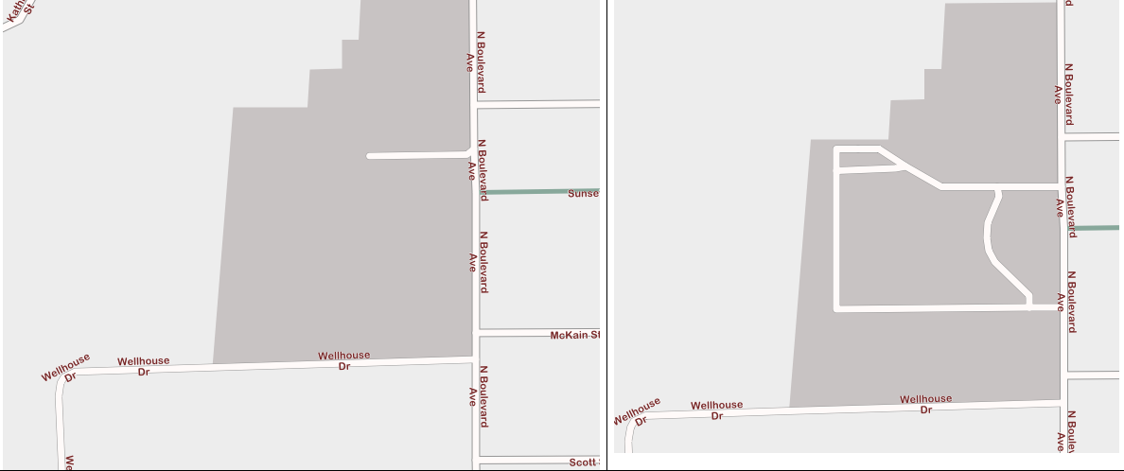
Samples

